Slide 1
WHY STUDY INSECTS?

Slide 2
Why Study Insects?
Most diverse and abundant macro-organisms
Filled nearly every niche on the plant
Fascinating adaptations to the enviornment
Ecological services
Disease vectors
Human’s #1 competitor for food

Slide 3
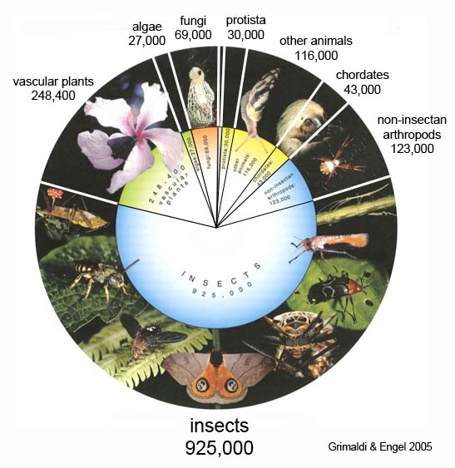
How Many Insects?
Named Species:
Take a guess?

Slide 4
How Many Insects
Total estimated number of species?
~ 925,000

Slide 5
What is an Insect?
Kingdom
Phylum
Class
Order
Family

Slide 6
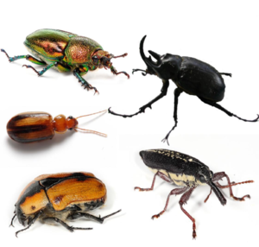
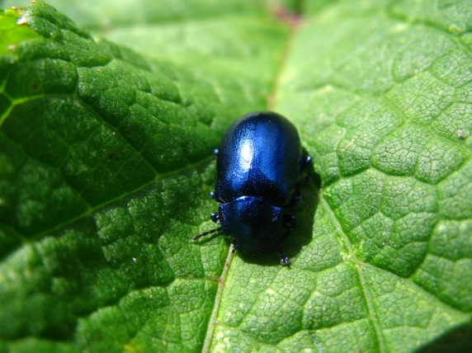
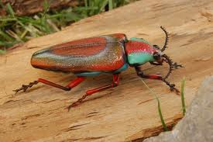
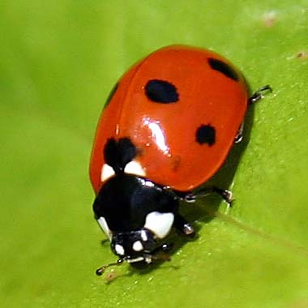
Coleoptera – beetles!!

Slide 7
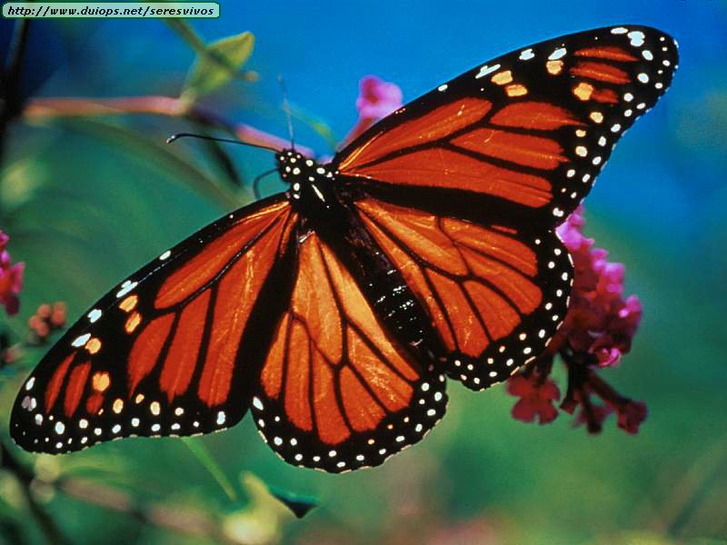
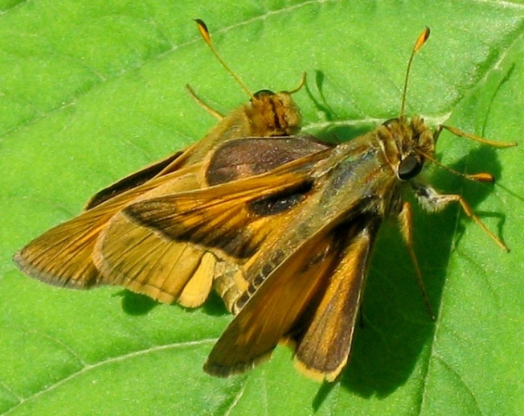
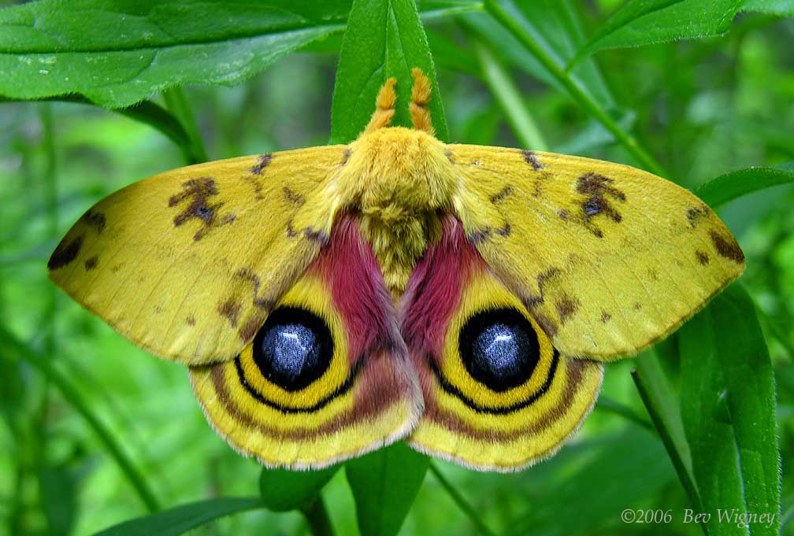
Lepidoptera – butterflies, moths and skippers

Slide 8
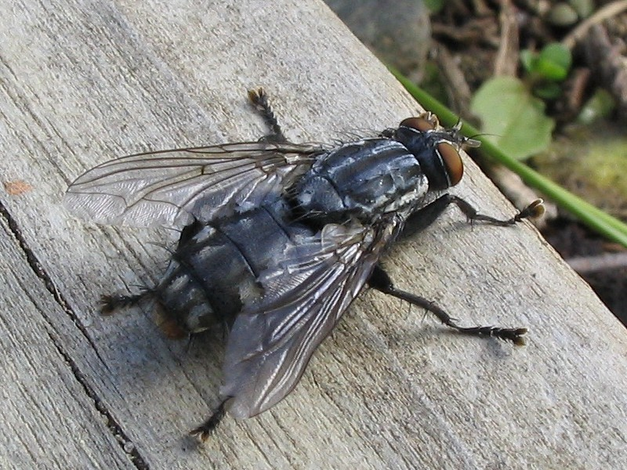
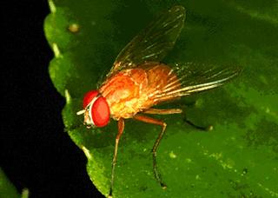
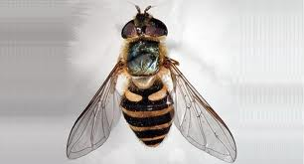
Diptera - flies

Slide 9
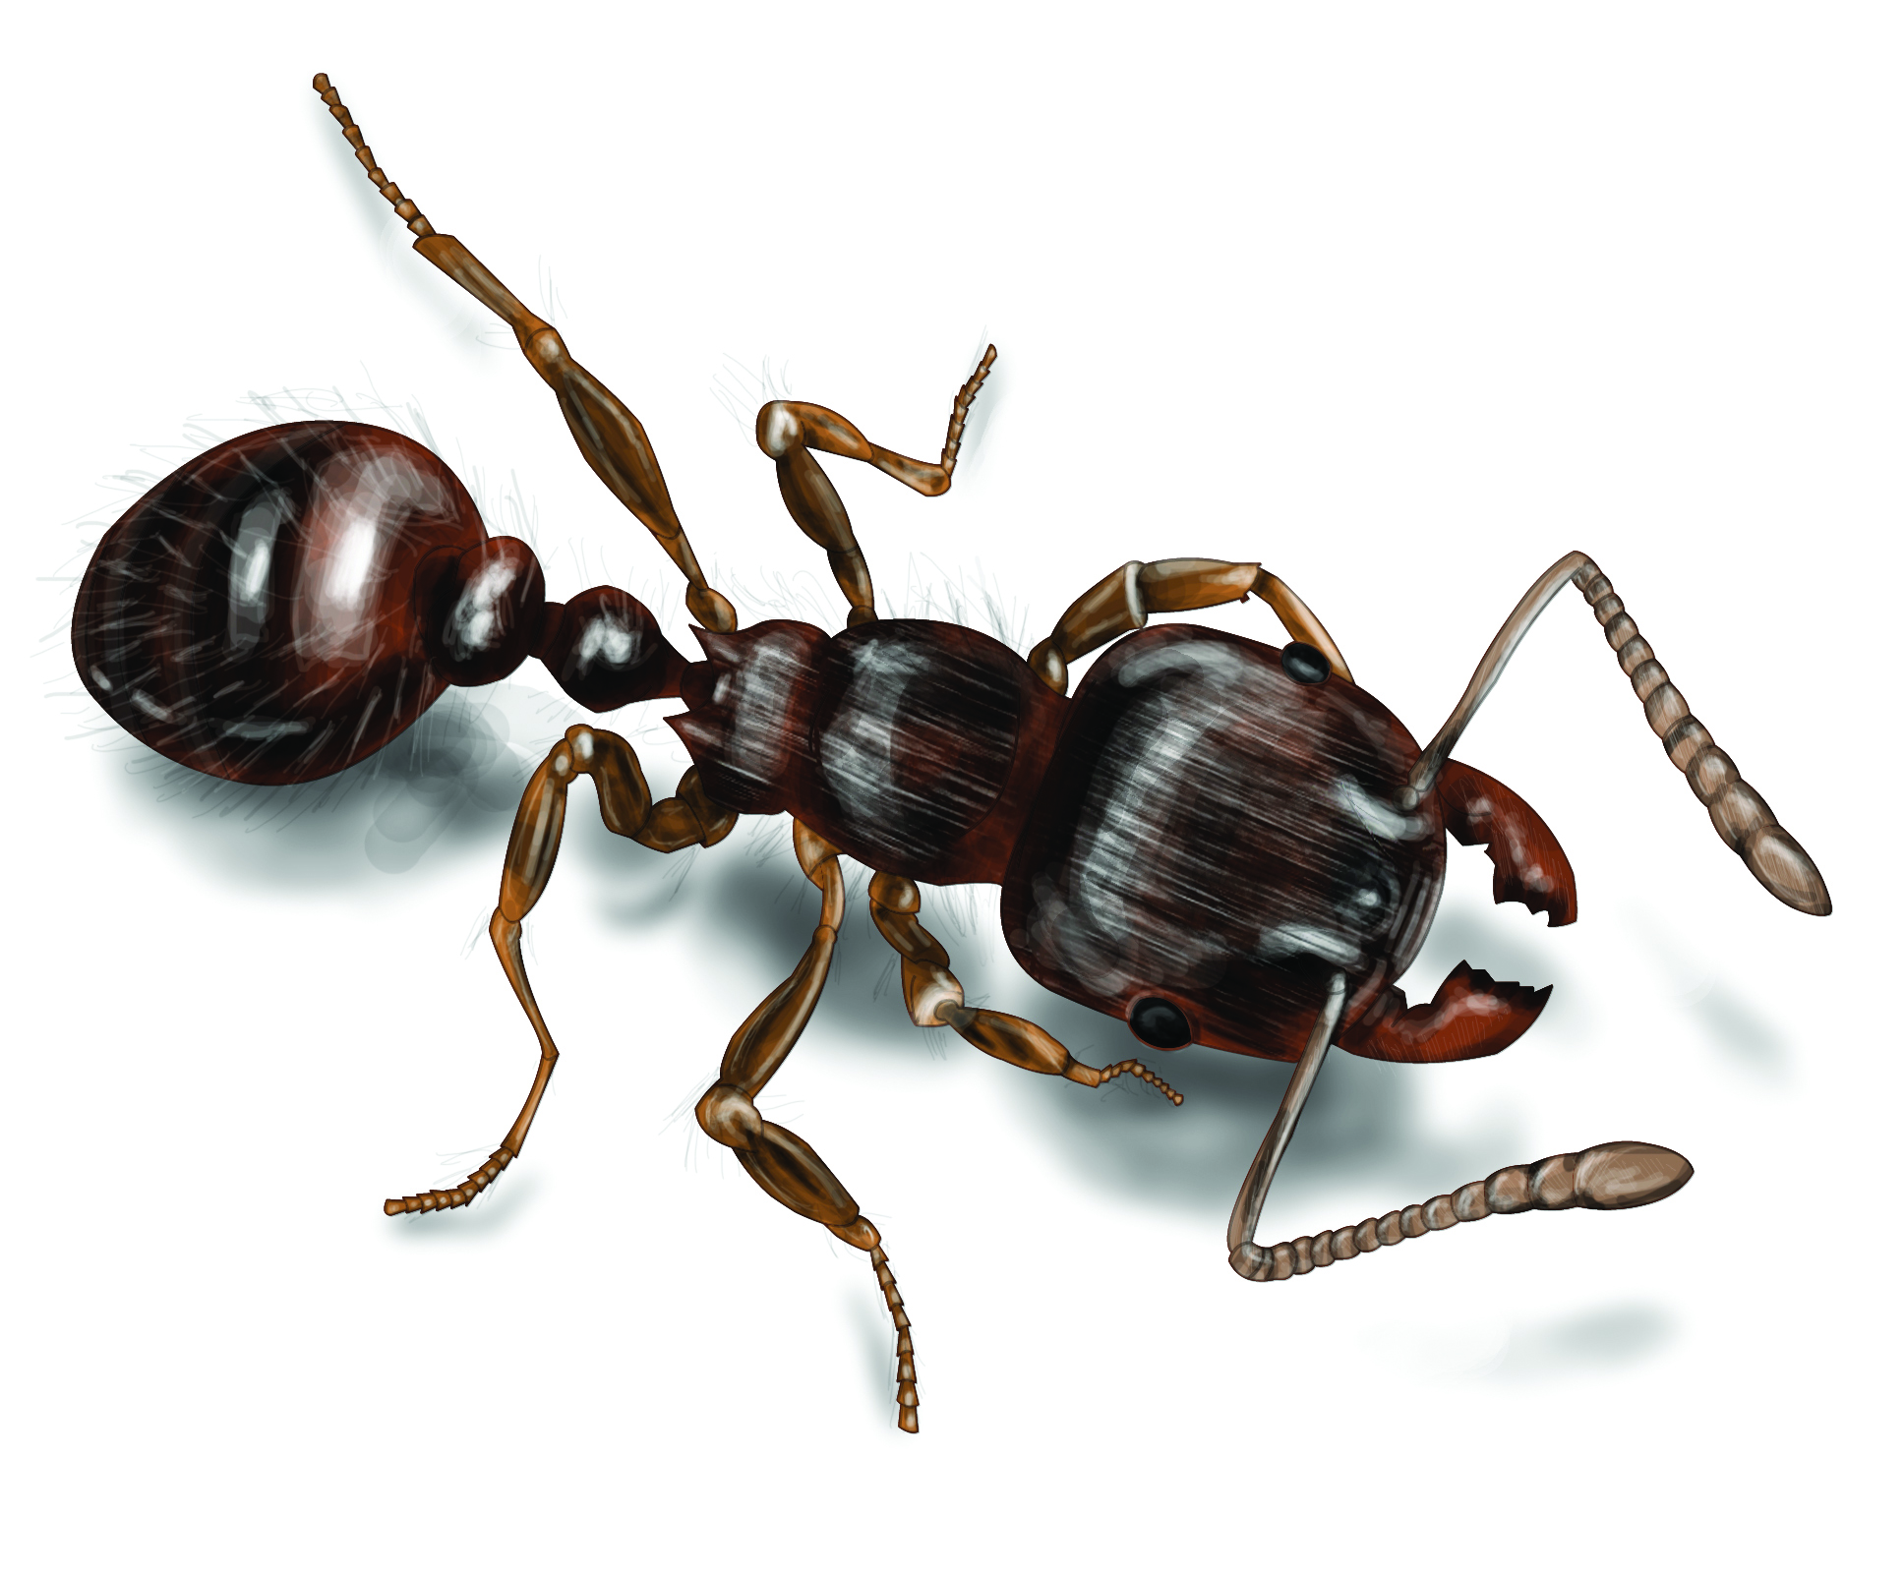
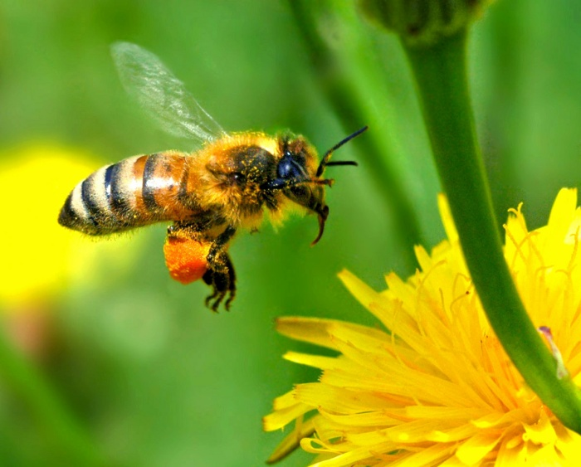
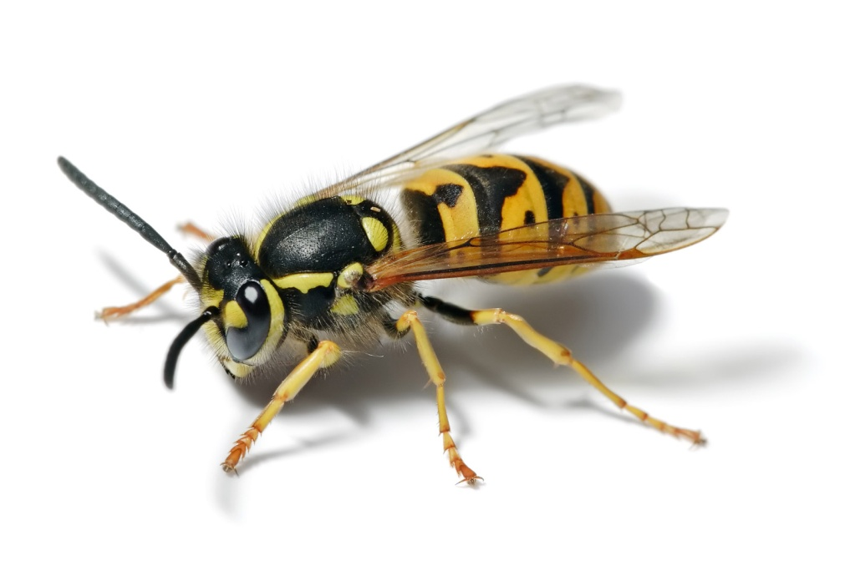
Hymenoptera – bees, ants, wasps, sawflies

Slide 10
What is an Insect
Some Key Features that distinguish insects from other arthropods
1)
2)
3)
4)

Slide 11
Why Are There So Many Insects?
1)
2)
3)
4)
5)

Slide 12
Slide Show of Insect Diversity Amazing Insect Adaptations and Insect World Records

Slide 13
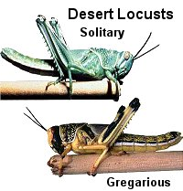
Fastest flier
African desert locust – Schistocera gregaria
(ORDER Orthoptera)
Airspeed: 33km per hour
(21 mph)

Slide 14
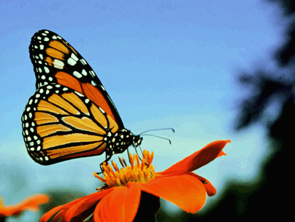
Farthest migration
Monarch butterfly Danaus plexippus
(ORDER Lepidoptera)
Up to 4000 km in 75 days (2485 miles)
Houston to St. Louis only 778 miles

Slide 15
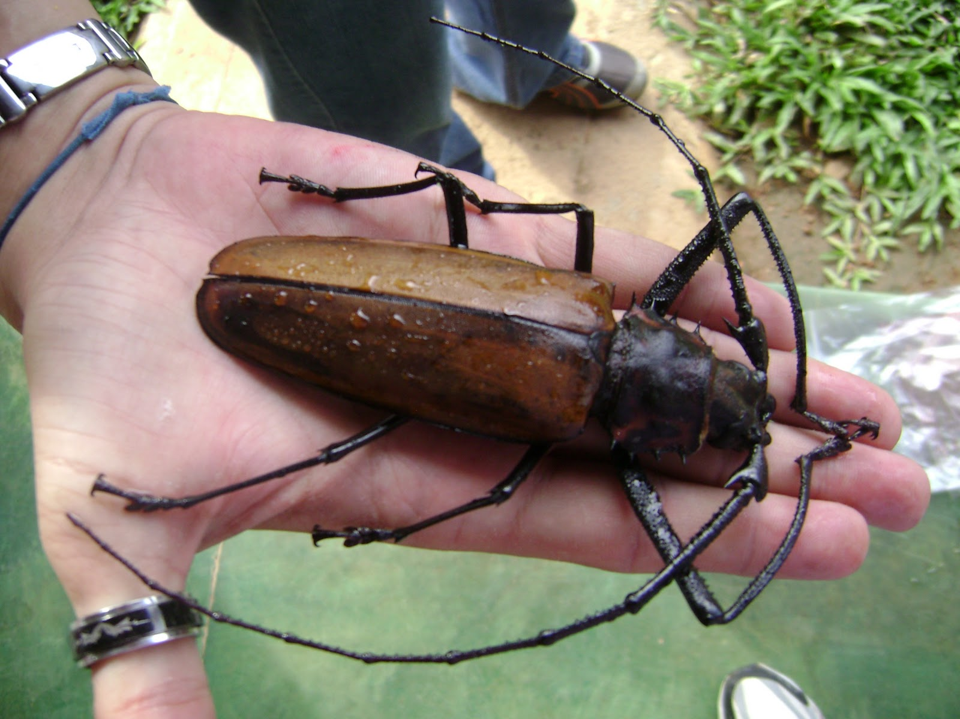
Largest Titanus giganteus (ORDER Coleoptera)
16.7 cm

Slide 16
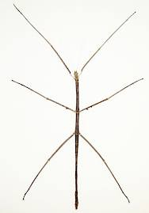

Longest Phobaeticus serratipes (ORDER Phasmatodea)
555 nm

Slide 17
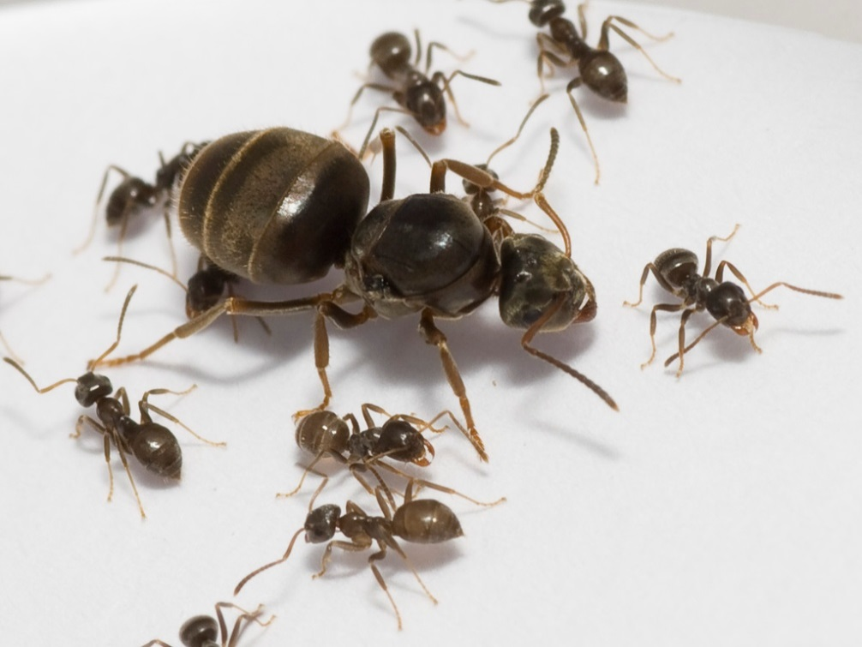
Longest adult life Lasius niger ant (queen) (ORDER Hymenoptera)
28.7 years in captivity

Slide 18
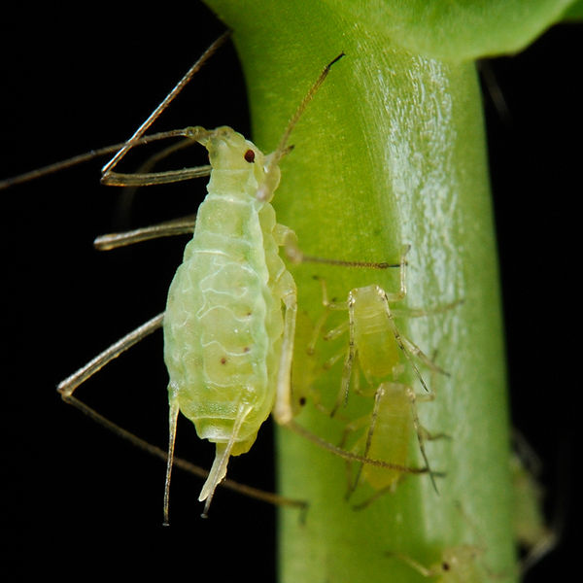
Shortest generation time Aphid – Rhopalosiphum prunifolia (ORDER Hemiptera)
4.7 days from egg-to-egg

Slide 19

Fastest evolving Laupala crickets, Hawaii (ORDER Orthoptera)
4.17 species per 1 million year
(10x faster than average!)

Slide 20
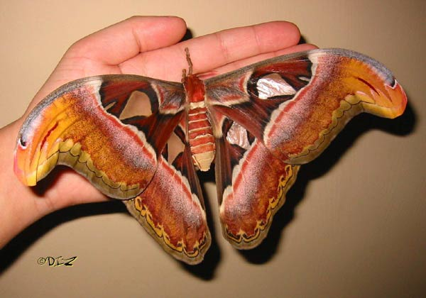
Biggest wings Atlas moth: Attacus atlas (ORDER Lepidoptera)
400 cm²

Slide 21
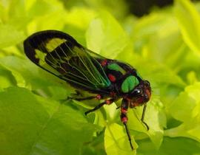
Loudest African cicada – Brevisana brevis (ORDER Hemiptera)
106.7 decibels at distance of 50 m (A jackhammer is 100 decibels)

Slide 22
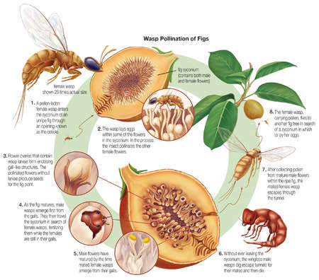
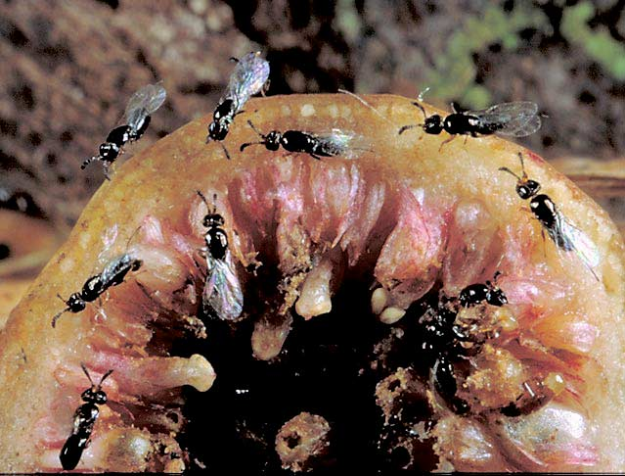
General host specificity Fig wasps (ORDER Hymenoptera)

